Slide 1


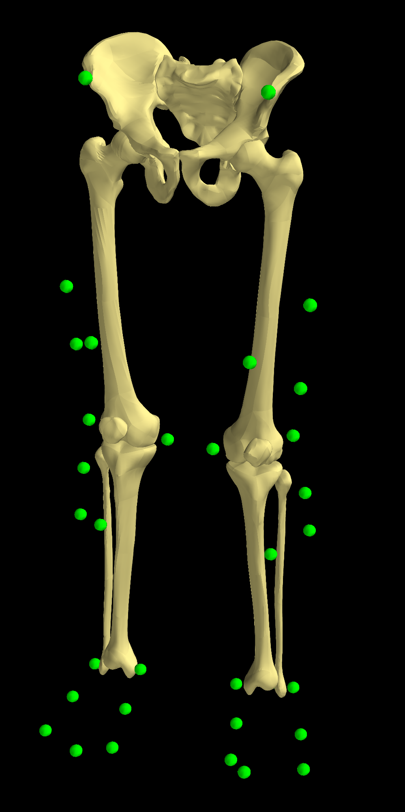
MAP
MAP Client FAI Workshop
September 2016
FAI Workflows

Slide 2
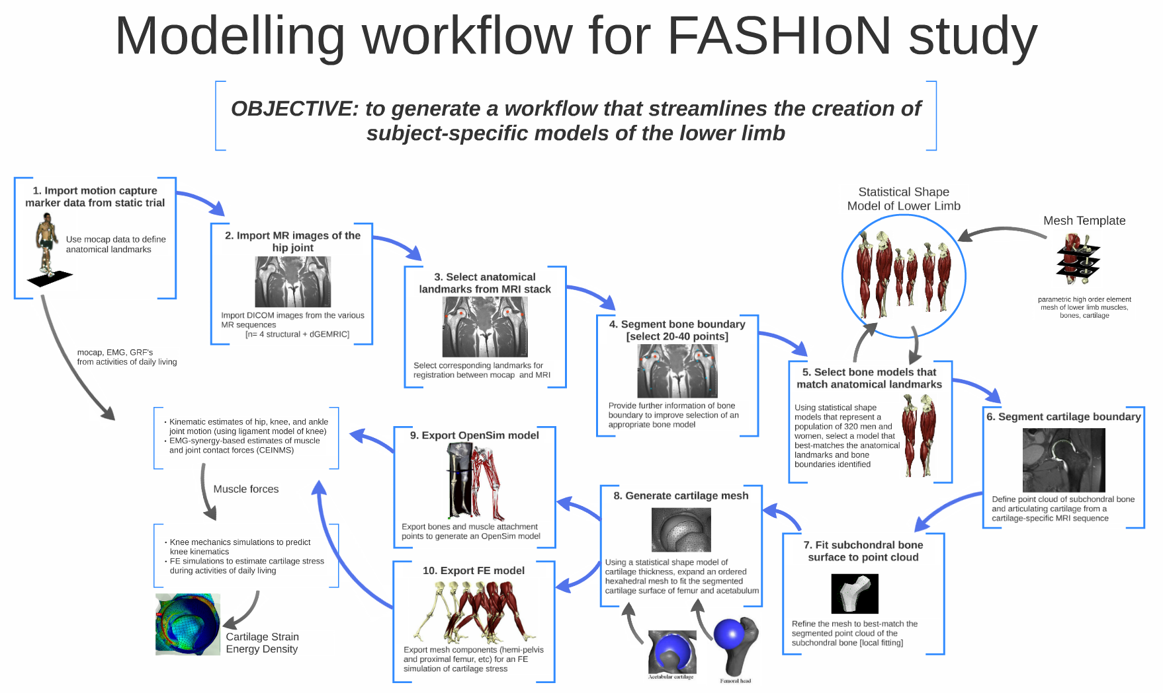

Slide 3

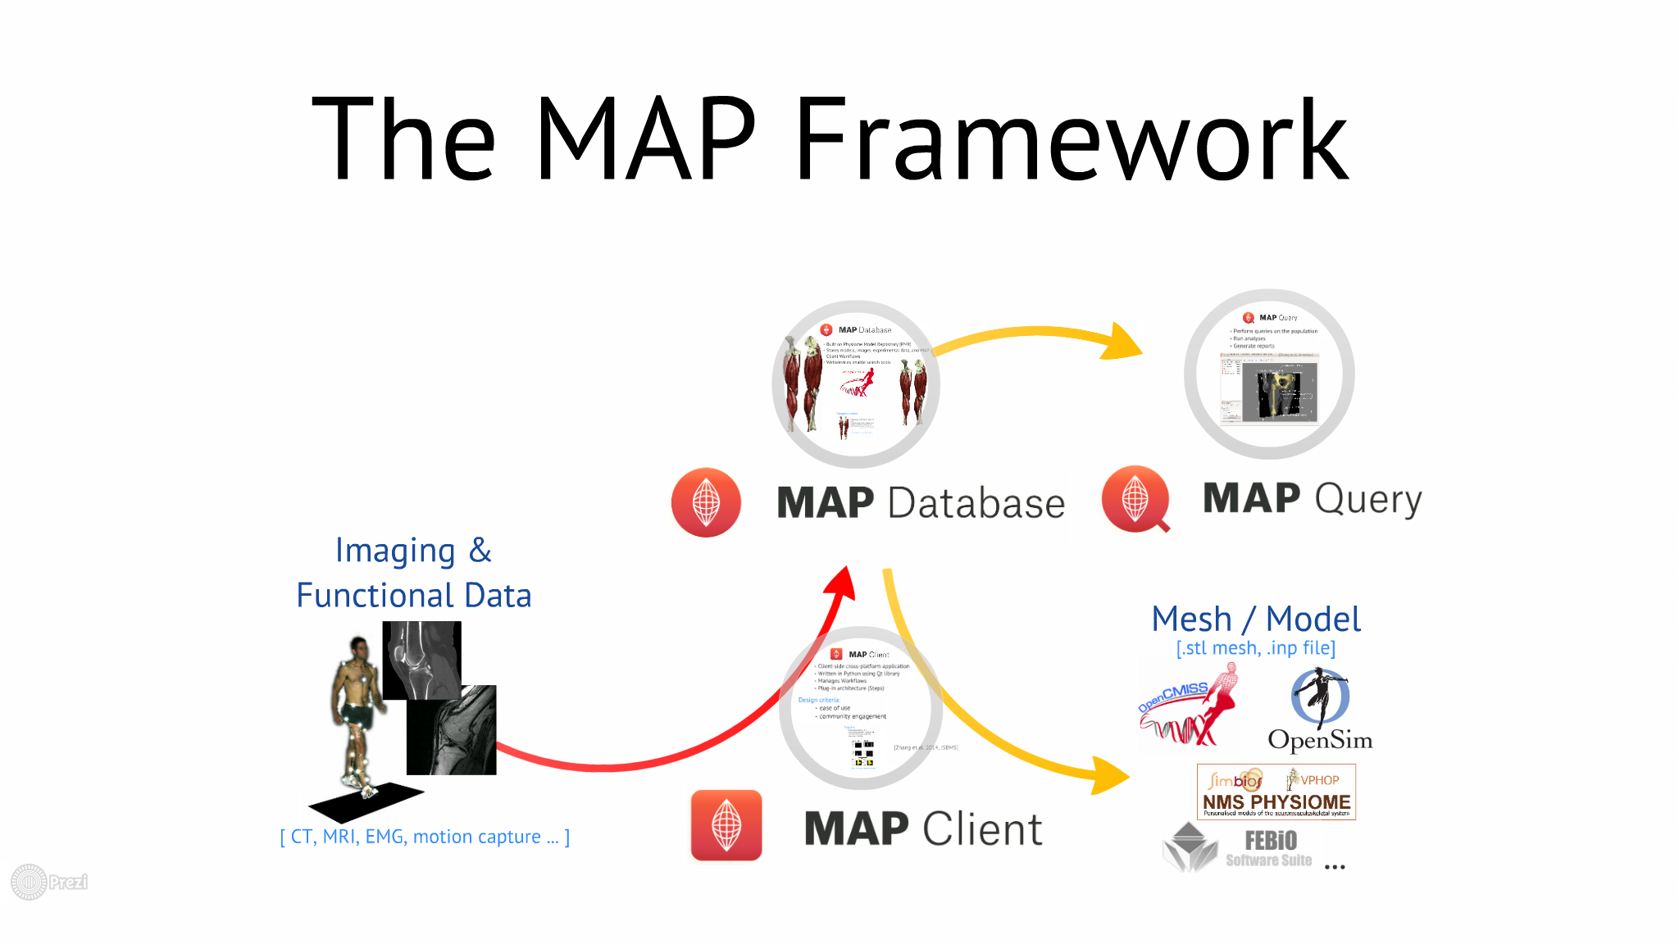
FAI & the MAP Client
Rigid-body model
MAP
Continuum model
Notes:
One goal of the MAP Client is to provide more patient specific rigid body models

Slide 4
FAI Workflows
Bone Mesh Generation
Lower-limb bone shape model to fuse mocap and sparse MRI segmentations
OpenSim Model Generation
Customise Gait2392 with geometric parameters from mocap markers and bone meshes

Slide 5
FAI Workflows
Rigid-body model
Bone Mesh Generation
Osim Model Generation
Continuum model

Slide 6
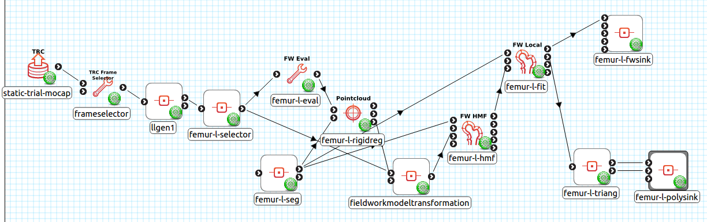
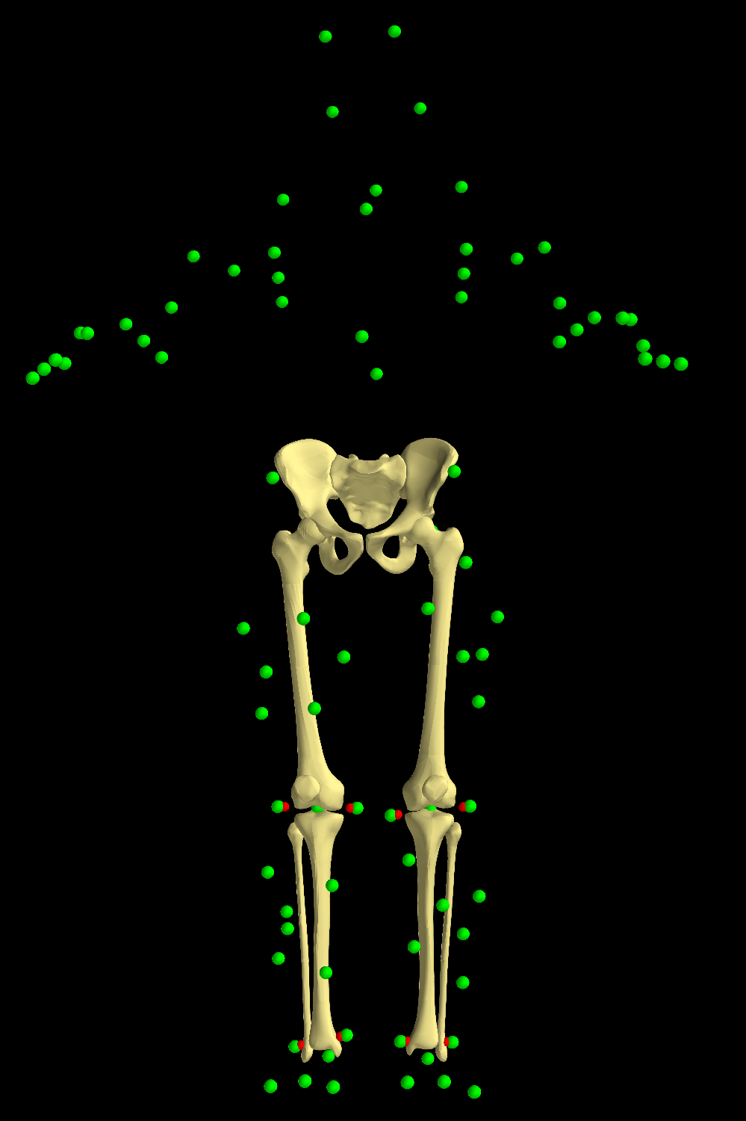
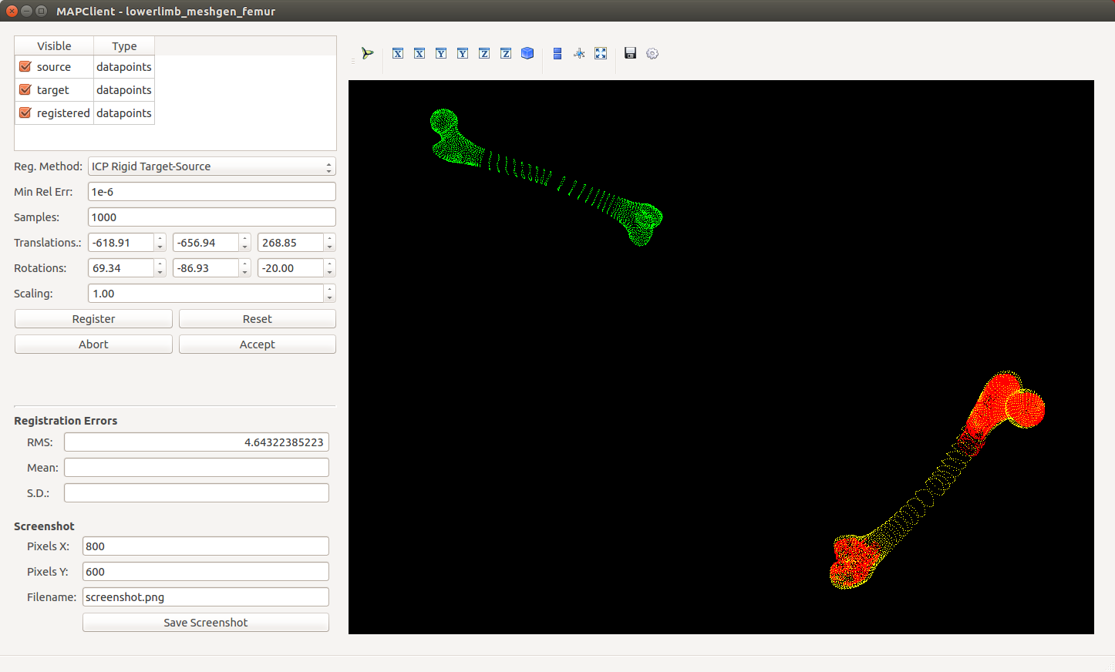
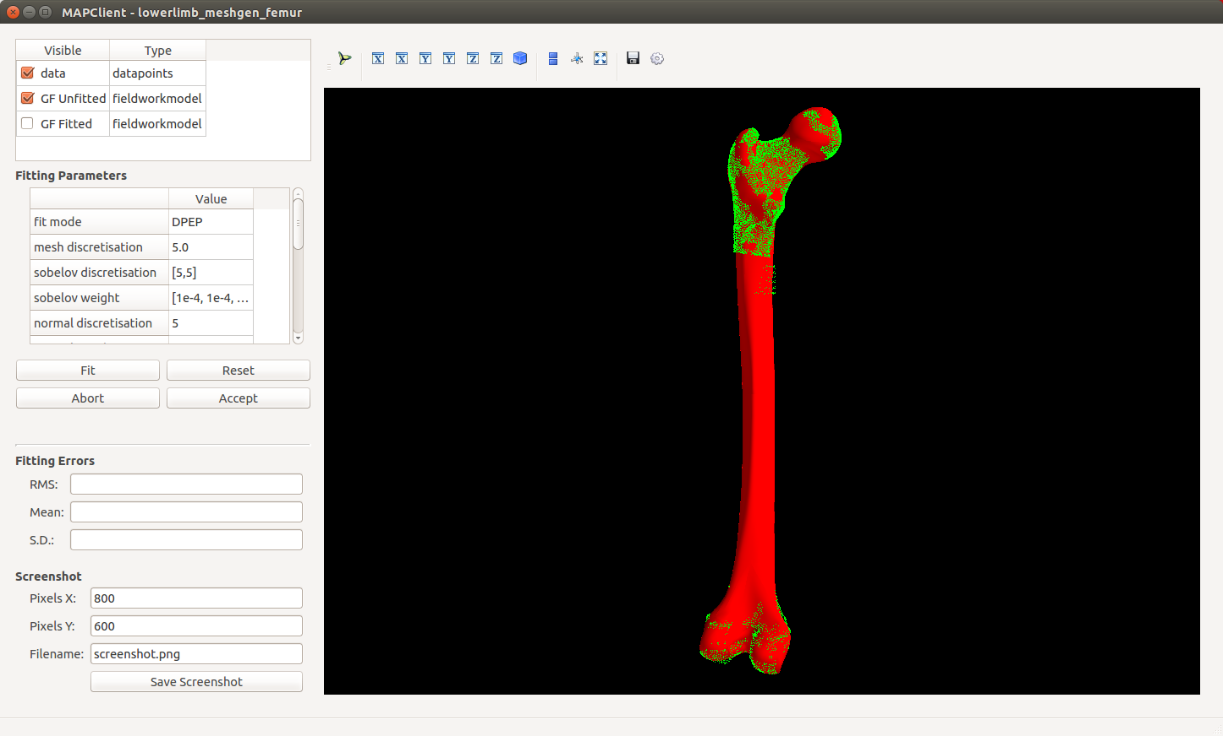
1. Bone Mesh Generation
Fit mesh locally to segmentation
Estimate bone shape from markers
Register mesh to segmentation

Slide 7
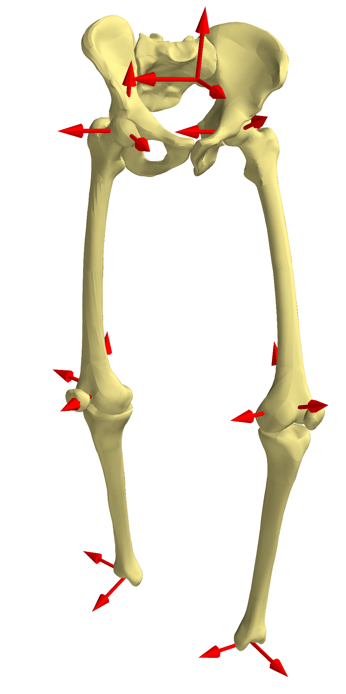
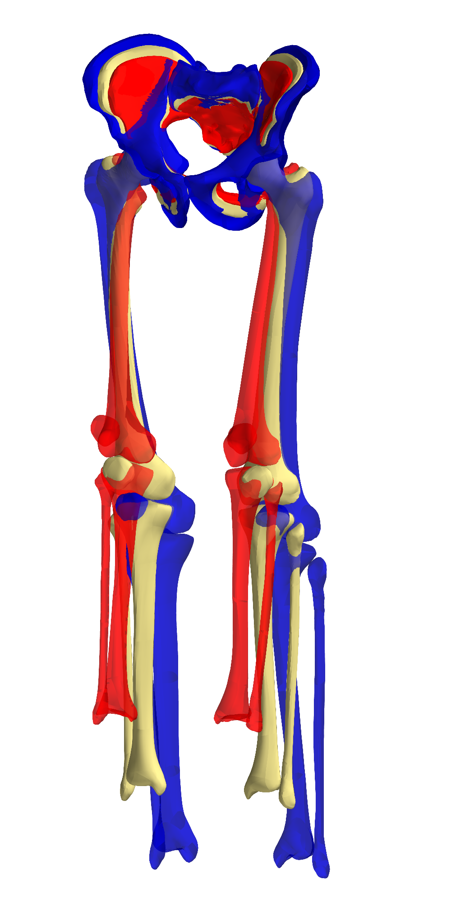
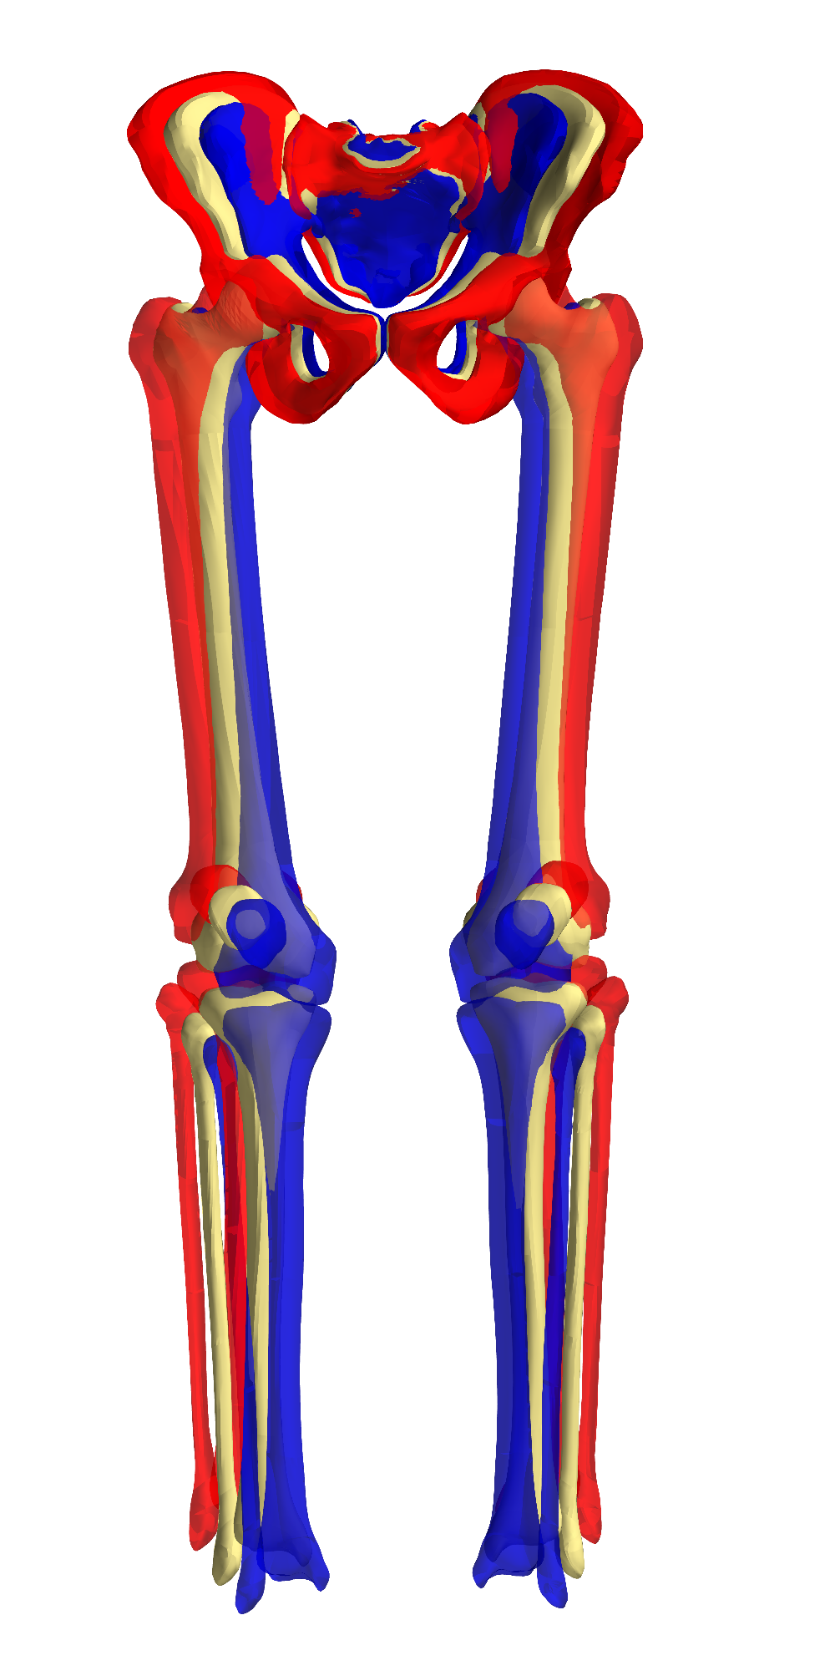
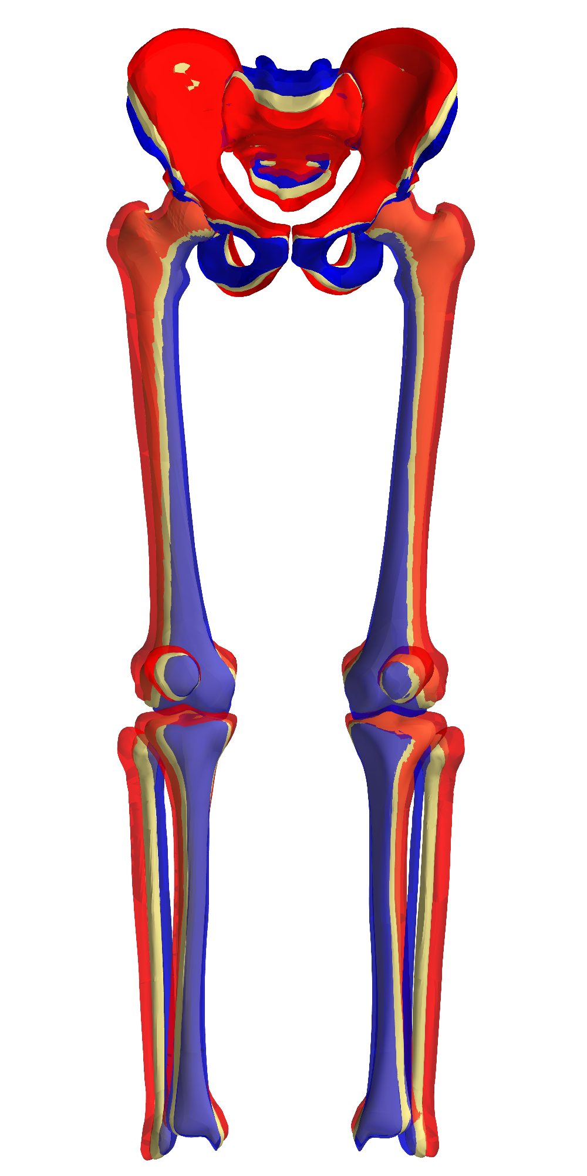
Lower limb shape model
=
+
+
PC1
PC2
PC3
Notes:
So we used a statistical shape model of the lower limb with articulation to predict realistic geometries from sparse data.

Slide 8
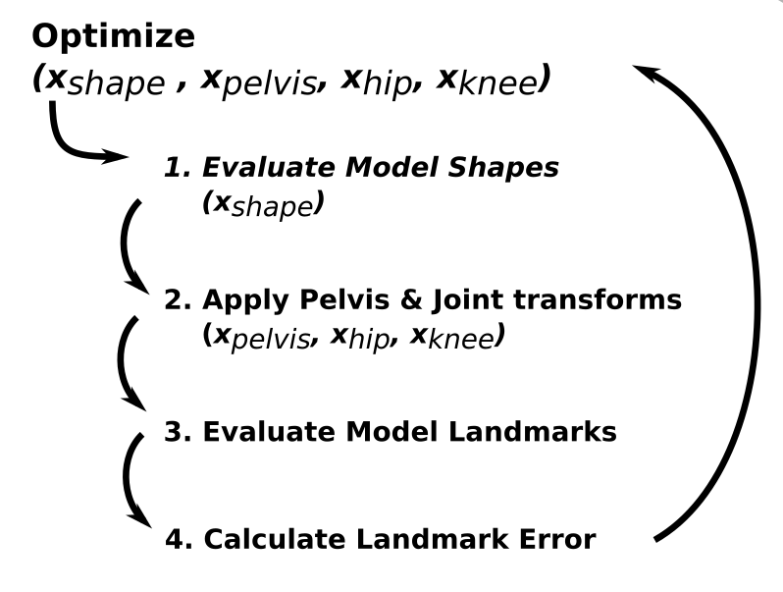
Marker Registration
[Zhang et al. (2016) In Review]
Notes:
The model is fitted to the markers in red by optimising its shape and kinematic parameters

Slide 9
Per-bone Fitting
Non-rigid least-squares fit of mesh to partially segmented surfaces
ICP Rigid-body registration to segmentation
Notes:
The model is fitted to the markers in red by optimising its shape and kinematic parameters

Slide 10
Lower Limb Marker Reconstruction Errors
Results
 | LL SM |  | Iso-scaling |  | p-value
 | mean(sd) | max | mean(sd) | max
Pelvis | 4.23 (1.05) | 6.12 | 5.46 (1.64) | 10.62 | <0.001
Femur | 4.57 (1.75) | 8.95 | 5.41 (2.15) | 10.20 | 0.02
Tibia and Fibula | 3.63 (0.79) | 5.80 | 3.67 (0.95) | 5.93 | 0.41
Patella | 5.59 (1.49) | 9.03 | 5.48 (2.04) | 12.05 | 0.35
Combined | 4.28 (0.80) | 6.06 | 5.22 (1.37) | 9.47 | 0.01
Target Landmark | 3.43 (1.31) | 5.34 | 6.82 (2.91) | 15.90 | <0.001
Val. Landmarks | 8.59 (2.29) | 14.37 | 10.82 (3.86) | 22.92 | 0.001
[Zhang et al. (2016) In Review]
Notes:
Surface error was around 4.5 mm RMS for the shape model estimated models, which was significantly better than isotropic scaling.
This was mainly due to much better estimations of pelvis and femur shape.
Landmark error was also significantly lower for the shape model
Model fitting converges for all shape model trials, while isotropic scaling failed for 6 subjects.

Slide 11
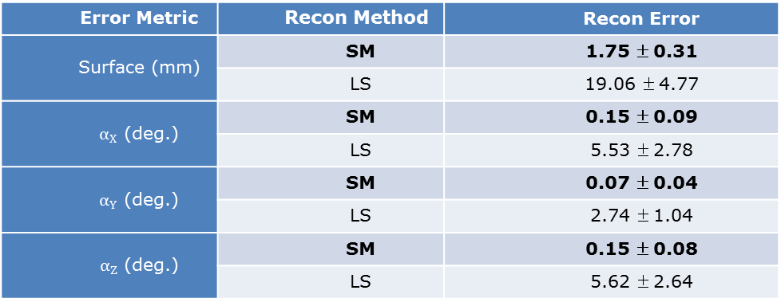
Femur Partial Reconstruction Errors
Error Metric | Recon Method | Recon Error
Surface (mm) | SM | 1.75 ±0.31
 | LS | 19.06 ±4.77
$α_{X}$ (deg.) | SM | 0.15 ±0.09
 | LS | 5.53 ±2.78
$α_{Y}$ (deg.) | SM | 0.07 ±0.04
 | LS | 2.74 ±1.04
$α_{Z}$ (deg.) | SM | 0.15 ±0.08
 | LS | 5.62 ±2.64
[Zhang et al. (2016) In Review]

Slide 12
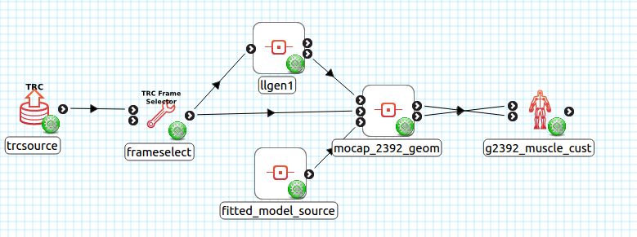
2. OpenSim Model Generation
Reassemble fitted meshes in mocap frame
Extract geometric properties to modify Gait2392

Slide 13
Patient-specific customisation
Joint locations
Inertial properties
Muscle path points
Visual geometry

Slide 14
Customising Gait2392
One of the most widely used OpenSim models
>115,000 downloads from simtk.org
>24,000 unique users

Slide 15
Customising Gait2392
Joint locations
Knee joint splines
Visual geometry

Slide 16
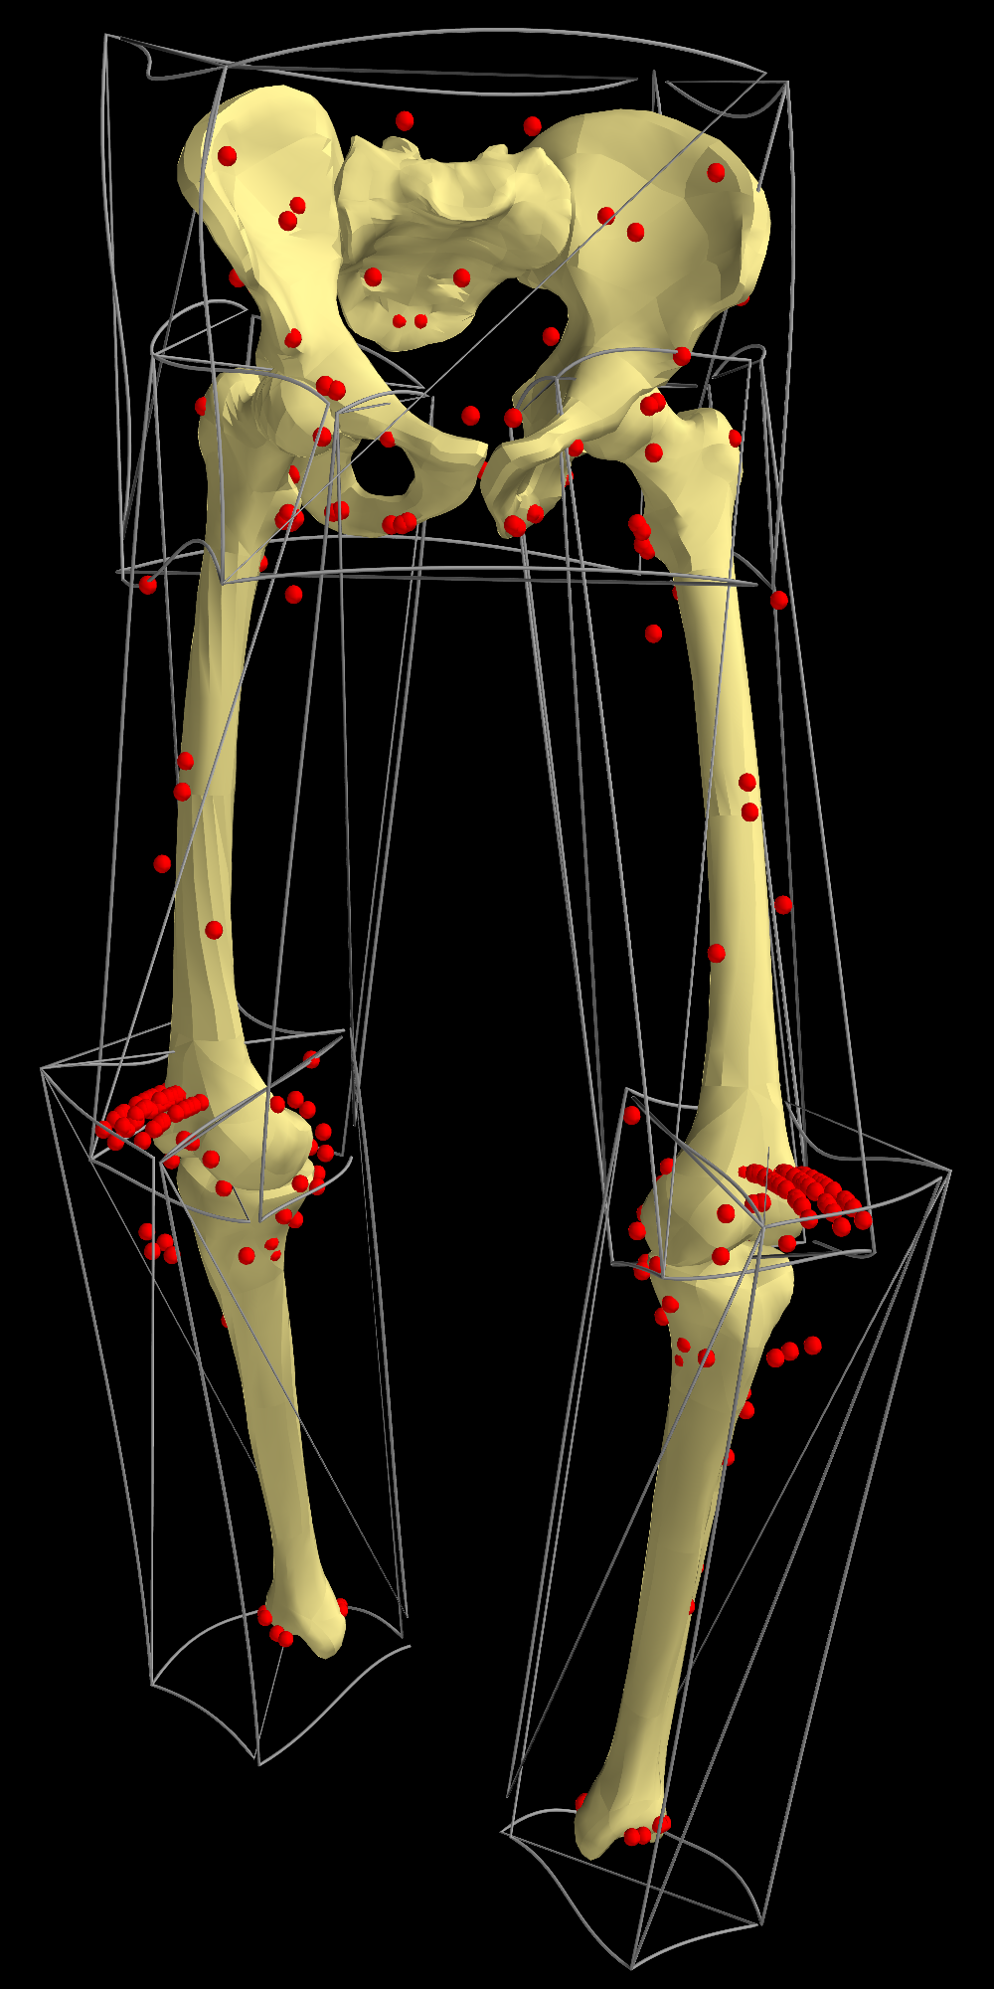
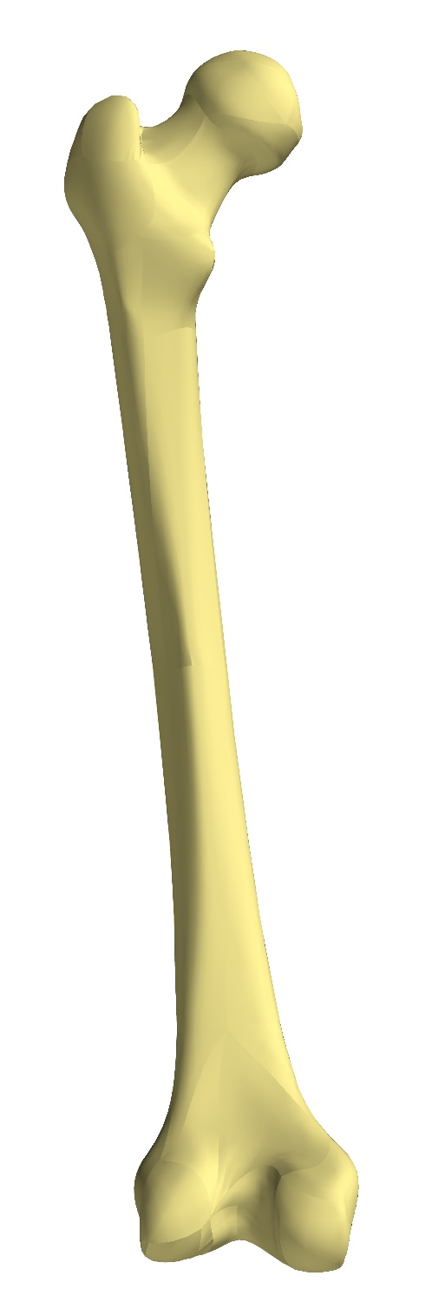
Customising Gait2392
Joint locations
Visual geometry
Muscle path points
Freeform deformation based on bone geometry
Gait2392
reference
Customised

Slide 17
Customising Gait2392
Joint locations
Visual geometry
Muscle path points
Scale factors from markers and meshes
Scaled inertial properties
Scaled torso, feet (no shape models)

Slide 18
Customising Gait2392
Joint locations
Visual geometry
Muscle path points
Scale factors from markers and meshes
Scaled inertial properties
Scaled torso, feet (no shape models)
Customisation performed using OpenSim Python API

Slide 19
Customising Gait2392
Validation
Hamner 2010 running model
Customise to published markerset
Compare customised model to published model
vs
[Hamner et al
(2010) J. Biomech]

Slide 20
Validation Against Hamner 2010
Model Parameter Differences
Parameter | Mean | S.D. | Max
Body Mass (kg) | 0.5 (2.4%) | 0.7 (10.4%) | 1.8 (21.1%) [pelvis]
Body CoM (mm) | 9.6 | 16.8 | 61.7 [torso]
Joint Loc. in Prt. (mm) | 26.6 | 26.8 | 69.4 [ankle_l]
Muscle Opt. Fib. Len (mm) | 4.7 (7.4%) | 10.9 (7.2%) | 30.5 (24.5%) [vas_med_l]
Muscle Tend.Sla.Len (mm) | 2.7 (7.4%) | 17.6 (7.2%) | 60.4 (24.9%) [rect_fem_l]
Muscle Path Pt. (mm) | 29.8 | 12.7 | 57.0 [grac_l]

Slide 21
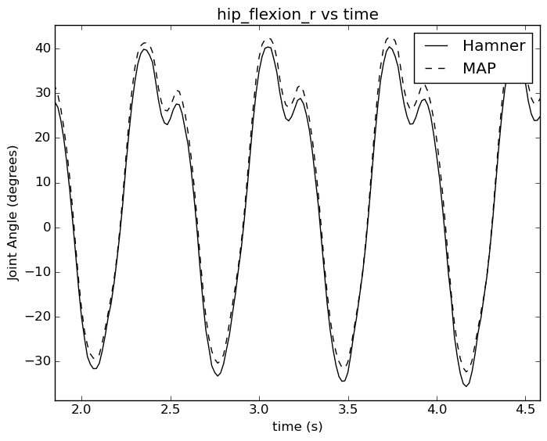
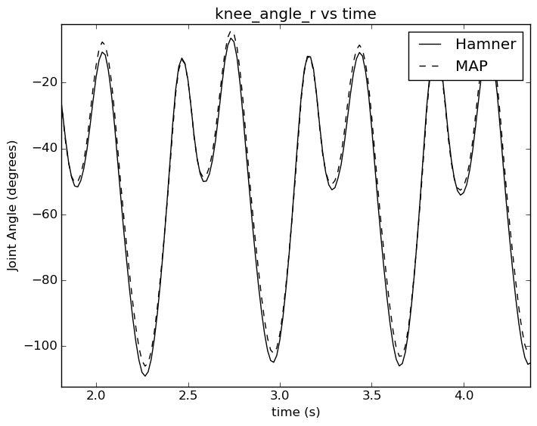
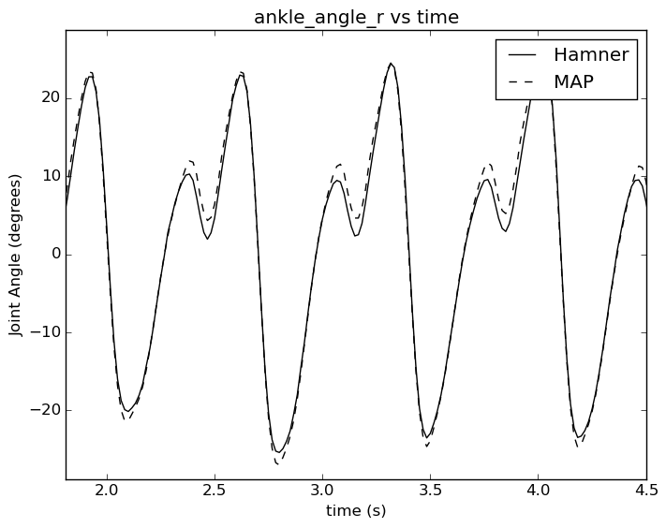
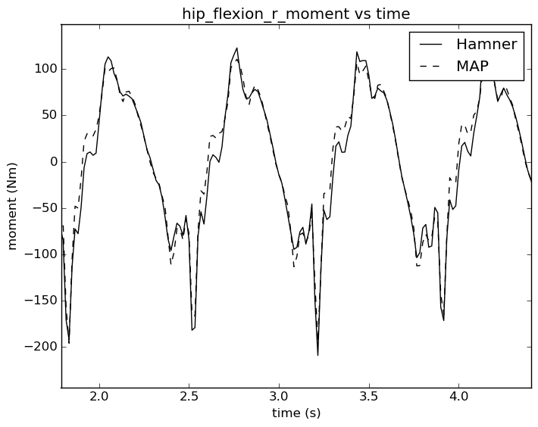
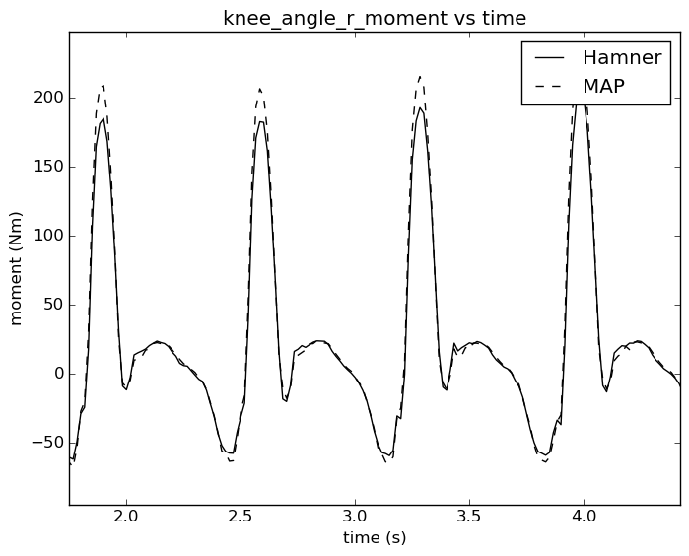
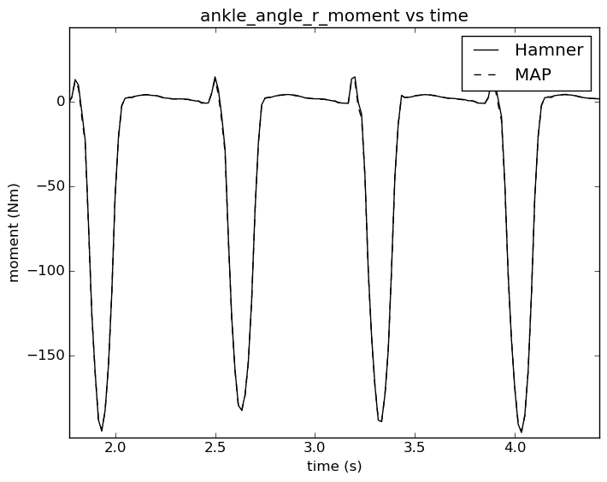
Validation Against Hamner 2010

Slide 22

Acknowledgements
MAP
NZ: Thor Besier
Hugh Sorby
Peter Hunter
Poul Nielsen
Justin Fernandez
Kumar Mithraratne
Vickie Shim
Duane Malcolm
AUS: David Lloyd
Mark Taylor
John Clement
David Thomas
OpenSim
Scott Delp
Jennifer Hicks
Ajay Seth
Ayman Habib
James Dunne
Chris Dembia
Tom Uchida
US Food & Drug Administration
National Center for Simulation in Rehabilitation Research

Slide 23
Build/Run Workflows
Follow instructions on the workflow pages.

